Slide 1

Final software presentation Laura Harrington University of Arizona Global Campus CST499 Capstone For Computer Software Technology Instructor Rangitsch June 17th, 2024

Slide 2
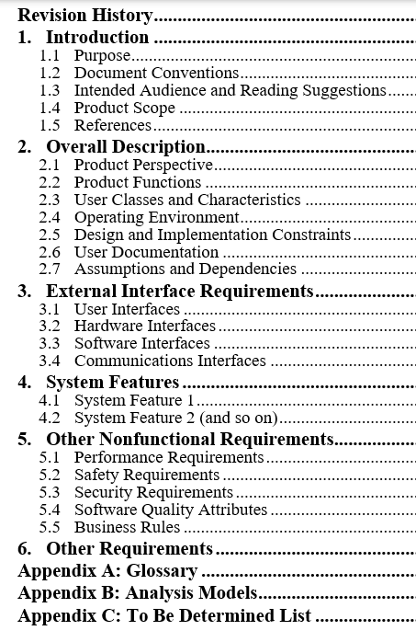
SRS Document
The introduction includes a description of The software system’s purpose and scope (Tsui et al., 2018).
The High-level description gives a description of the software product. Highlighting major functions and user characteristics. Any major constraints and dependencies are also called out for awareness (Tsui et al., 2018).
Then the requirements are provided in as much detail as possible, use cases are also listed (Tsui et al., 2018)
The document should be reviewed by several members of the team but is signed off by the project managers, stakeholders at a minimum.

Slide 3
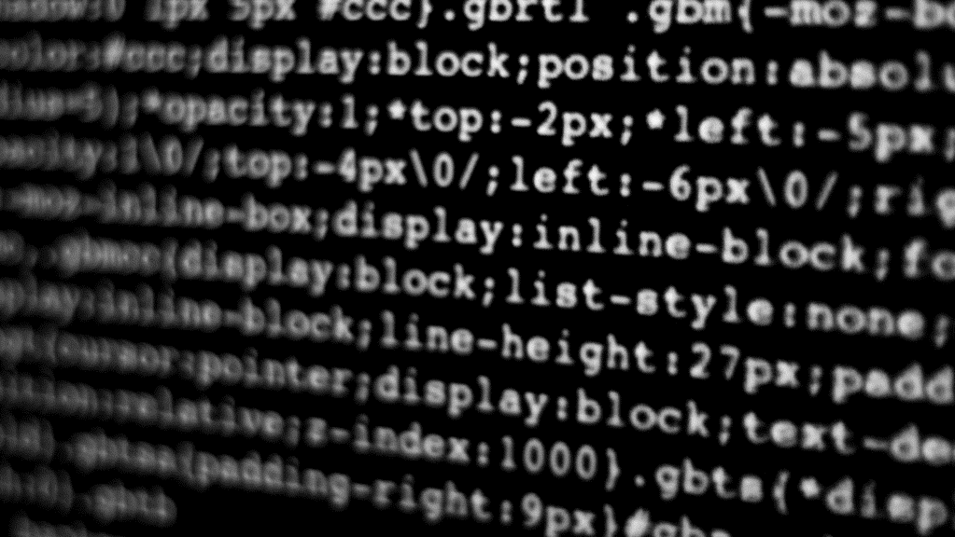
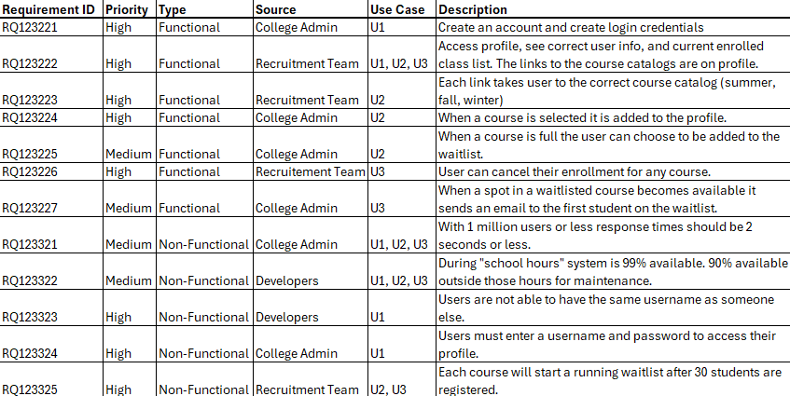
Requirements
Non-Functional Requirements – the requirements that are more focused on the background of the system. How the system performs, if it is reliable, and types of security and or privacy policies the system must follow (Functional vs. Non-functional requirements, 2021).
Functional Requirements - the requirements that involve the system’s behavior and how the software should perform while a user interacts with the system. Certain functional requirements involve different levels of access to the system, and certain error messaging that pops up when a user enters an incorrect password or username that has been used already (Functional vs. Non-functional requirements, 2021).

Slide 4
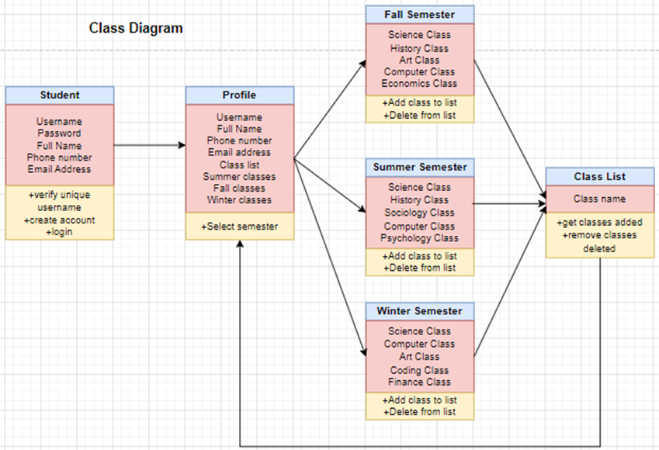
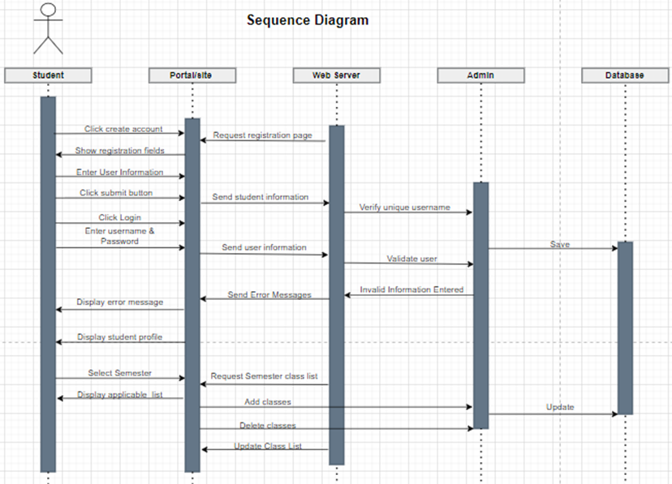
UML Diagrams
Unified Modeling Language – A standardized language utilizing a set of various diagrams to aid software developers by specifying, visualizing, constructing, and documenting the various actors, objects, and their relationship to one another (What is Unified Modeling Language (UML)?, n.d.).
The diagrams used for the student portal Project were: Class Sequence State Activity Use Case

Slide 5
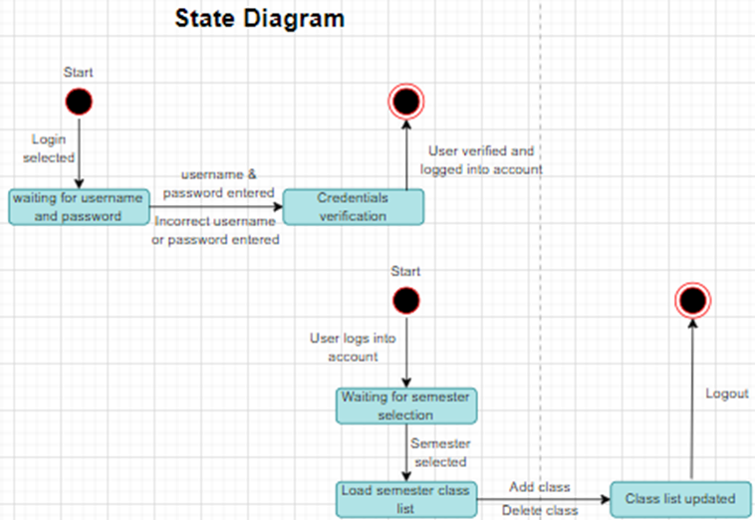
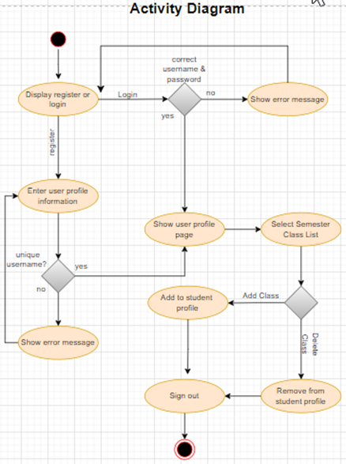
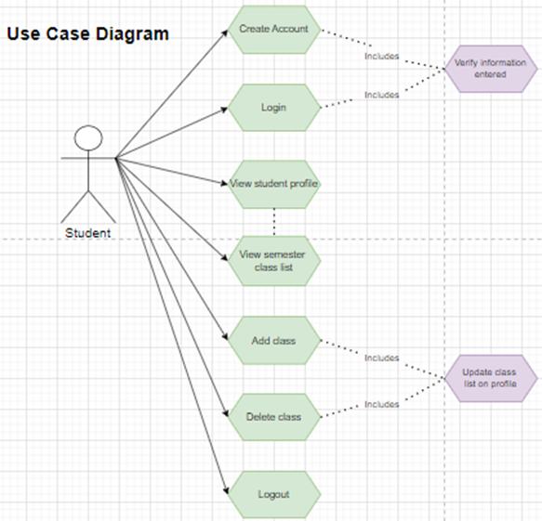
Diagrams & Strategic Design
Through the diagrams used the team can come up with the best ways to design the system. Taking into consideration:
The different objects and how they interact with one another. (Class Diagram)
The sequence of events within the system as a user performs basic functions. (Sequence Diagram)
The different states the system will be in before and after information is entered in the system or selected. (State Diagram)
The different activities the system is capable of depending on what choices are made or information is entered by the user. (Activity Diagram)
The different objects or parts of the system that a user will directly interact with. (Use Case Diagram)

Slide 6
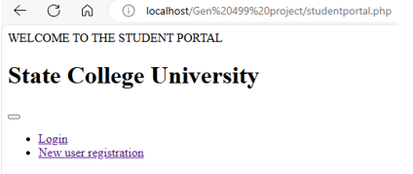
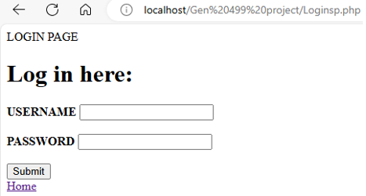
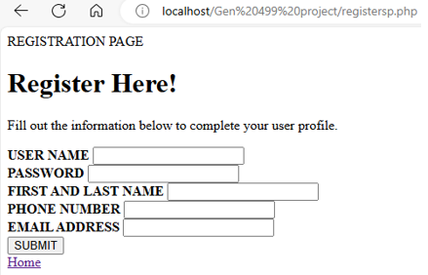

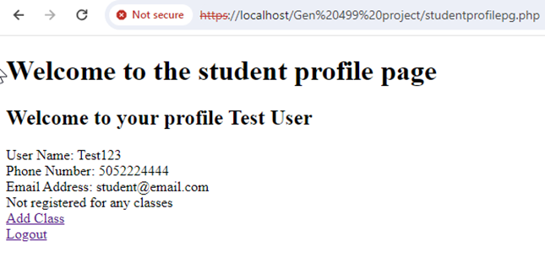
Student Portal Part 1
- LANDING PAGE - LOGIN PAGE - ENROLLMENT PAGE -

Slide 7
SYSTEM FLOW
Each page of the student portal is connected to a MySQL database. This allows for information to move from the website to the database.
As information is entered into the registration page it is stored within a table in the database. When a user is done saving their user information, they are able to log into their user profile using the username and password.
After they are logged in, they are immediately routed to their specific profile page which lists personal details and any classes the student is enrolled in.
ERROR MESSAGING
The error messages throughout this process are triggered when: A new user tries to enter a username that has been used by a student already.
A user attempts to login with a username or password that doesn’t match the usernames and passwords saved in the database.
The system isn’t able to complete the action of saving a new user.

Slide 8
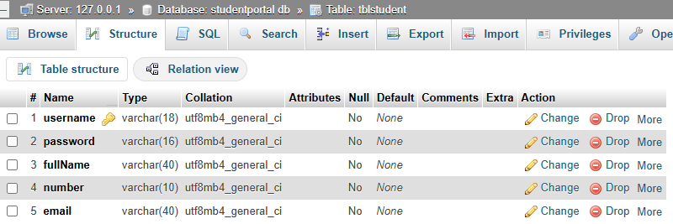
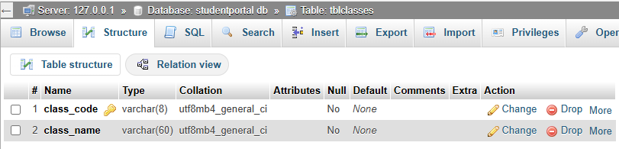
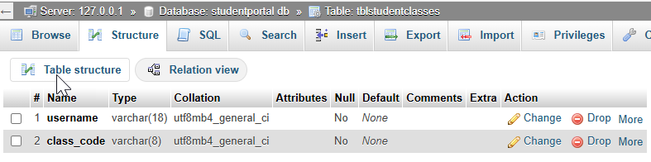
Student Portal Part 2
-Mysql Database-
The student portal database is made up of 3 tables.
The first table (tblstudent) holds all new and existing user information entered on the registration page. Throughout the student portal this table and it’s information is called on to ensure student privacy.
The second table (tblclasses) holds all classes available to the students. This information is stored within a table and appears in the form of a drop down on the add classes page of the student portal.
The third and final table (tblstudentclasses) allows classes selected by student users to be stored and displayed on the student profile page, by utilizing the two primary keys from the other two tables in the database.

Slide 9
MYSQL FUNCTIONS UTILIZED
INSERT – This function is used to add information into corresponding rows in a table. It can also be used to add actual rows to a table (Widenius et al., 2002).
DELETE – This function is used in the student portal to remove classes from the student profile by deleting rows from the database when certain information matches within the table (Widenius et al., 2002)
SELECT – This function is used mainly with the FROM table clause because when information from the table is being selected it is often being compared for security/privacy purposes (Widenius et al., 2002).
EXAMPLES

Slide 10
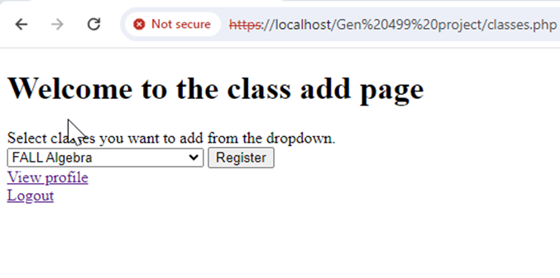
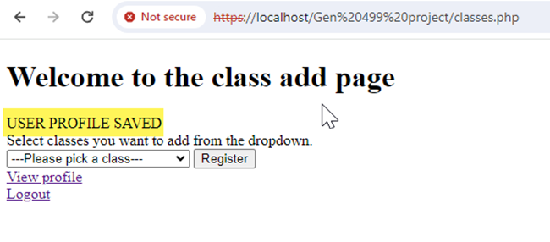
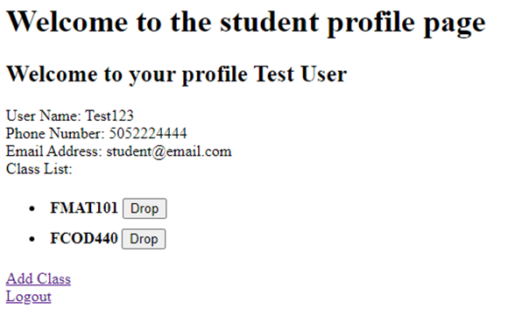
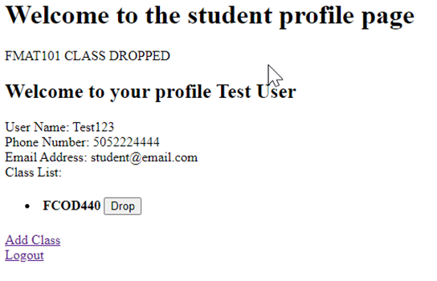

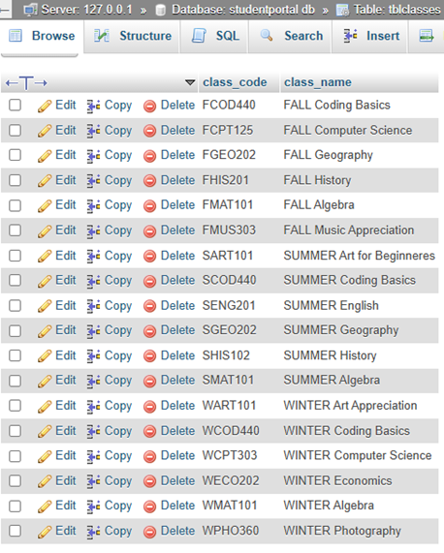
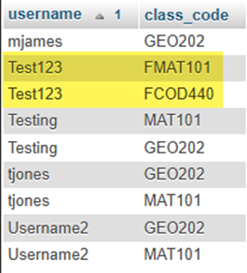
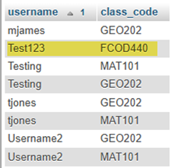
Student Portal Part 3
- Adding classes - Dropping classes -

Slide 11
CONFIRMATION MESSAGING
Specific messaging appears after a student saves a class from the drop-down menu on the add class page to let them know their account was updated.
Specific messaging appears after a student clicks on the “drop” button next to a class on their student profile to let them know the class was successfully removed from their schedule.
SYSTEM FLOW
After a student is logged in they can navigate to the “Add a Class” page within their account.
They can select classes to add to their schedule. The class codes appear in a list on their student profile page.
The class registration functionality is tightly connected with the MySQL database.
To successfully add classes and drop classes all three tables that make up the database must be utilized.

Slide 12
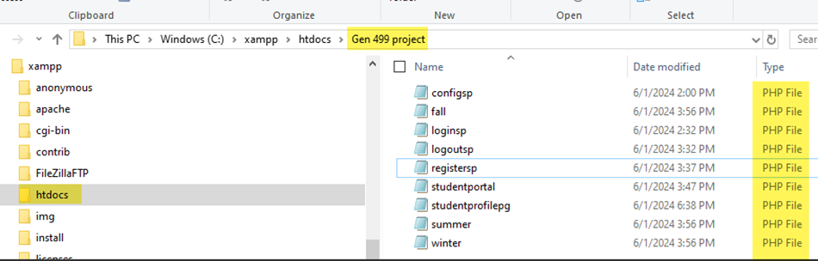
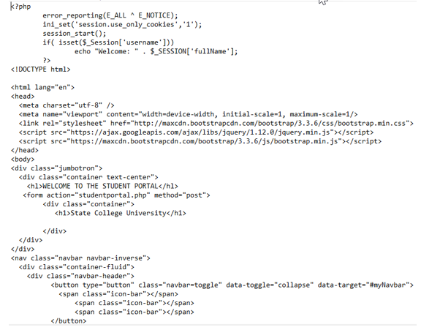
pHP CODE
About PHP:
PHP is a popular programming language that is executed on a server rather than a browser, like HTML (Agarwal, 2024).
PHP is easily integrated with databases like MySQL (Agarwal, 2024).
PHP is easily embedded into HTML code (Agarwal, 2024).
How I used PHP:
Every functional piece of the system is driven by PHP code. It stores all of the business logic for the software system. This includes information requested from users and error codes that appear when something goes wrong.
Throughout the entire student portal PHP and HTML is utilized to create a clean user interface and smooth/consistent flow from registration to logout. Using PHP information transfers easily into the MySQL database created for this project.

Slide 13

References
Agarwal, H. (2024, February 22). PHP introduction. GeeksforGeeks. https://www.geeksforgeeks.org/php-introduction/
Functional vs. Non-functional requirements. (2021, September 3). Jama Software. https://www.jamasoftware.com/requirements-management-guide/writing-requirements/functional-vs- non-functional-requirements
Tsui, F., Karam, O., & Bernal, B. (2018). Essentials of software engineering (4th ed.). Jones & Bartlett Learning.
What is Unified Modeling Language (UML)? (n.d.). Visual-paradigm.com. Retrieved June 17, 2024, from https://www.visual-paradigm.com/guide/uml-unified-modeling-language/what-is- uml/
Widenius, M., Axmark, D., & MySQL, A. B. (2002). MySQL reference manual: Documentation from the source. “O’Reilly Media, Inc.”

